Slide 1
Responsive Web Design
Eng/Ryhab farouq

Slide 2
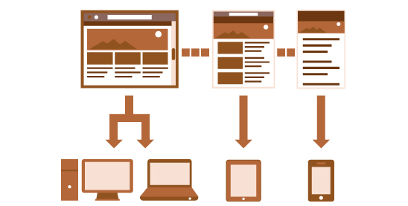
Meaning of RWD
Responsive design teams create a single site to support many devices, but need to consider content, design and performance across devices to ensure usability.

Slide 3
RWD
Responsive Web Design was first introduced by Ethan Marcotte in 2009.
Welcome to Ethan Marcotte’s website — Ethan Marcotte
Think responsively.. Think Mobile First

Slide 4
Viewport
Viewport is defined area to display website independent on device screen.
Identify and control viewport and its initial scale factor to override useragent.
<meta name=“viewport” content=“”/>

Slide 5
Terminologies
Responsive design is where website isn’t fixed with single size, It responds to users’ device automatically
Adaptive design is where created website redesign itself as per the device size
Negative space is empty space between elements to it more readable & standout
▻ padding or margins are great strategy to create it

Slide 6
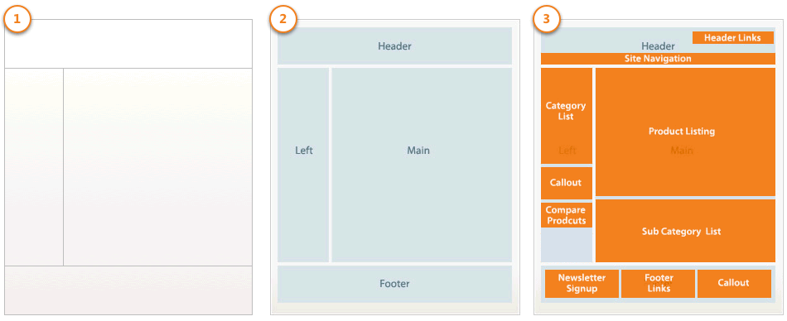
Web Layout

Slide 7
RWD Fundamentals
Flexbox
Grid system
Media queries
Responsive frameworks ‘bootstrap’

Slide 8
Flexbox

Slide 9
Flexbox
One dimensional layout model .
Flexible and efficient layouts
Distribute space among items
Control their alignment

Slide 10
Why Flexbox ?
A lot of flexibility
Arrange items
Spacing
Alignment
Order of items
Bootstrap is built on top of the flex layout

Slide 11
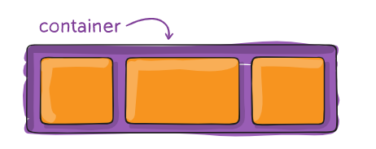
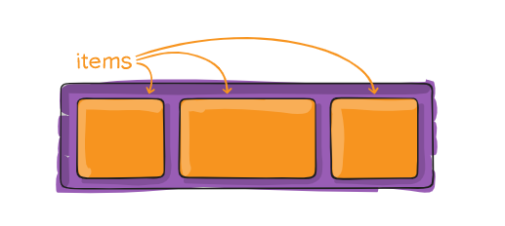
Terminology
Flex container
Flex items

Slide 12
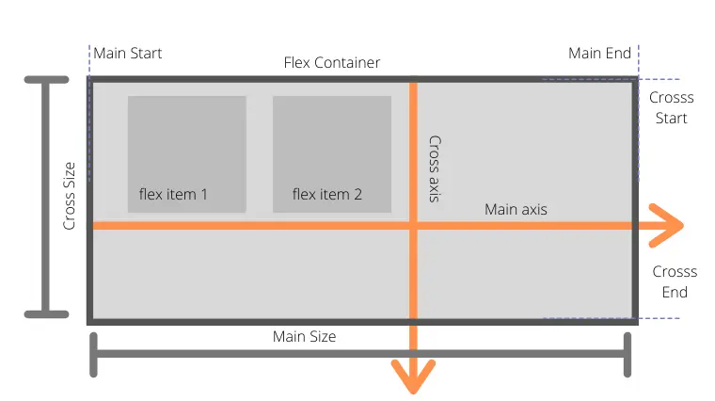
Flexbox Axes
Main axis
Cross axis

Slide 13
Flex Container Properties
Display
Flex-direction
Flex-wrap
Flex-flow
Justify-content
Align-items
Align-content

Slide 14
Display
Create either a block level or inline level flex container.
Flex
Inline-flex

Slide 15
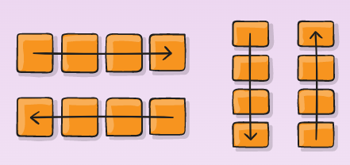
Flex-direction
Sets the direction of the main axis.
Row ➔ Default value
Row-reverse
Column
Column-reverse

Slide 16
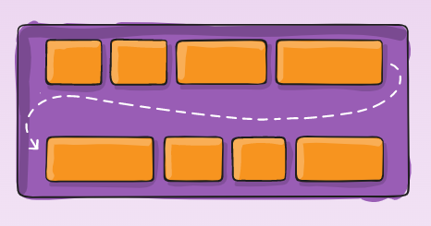
Flex-wrap
Control the wrapping of flex items within the container.
Nowrap ➔ Default value
Wrap
Wrap-reverse ➔ push the last item above instead of below

Slide 17
Flex-flow
Shorthand for flex-direction and flex-wrap.
Flex-flow : <flex-direction> <flex-wrap> ➔ the Default is row nowrap

Slide 18
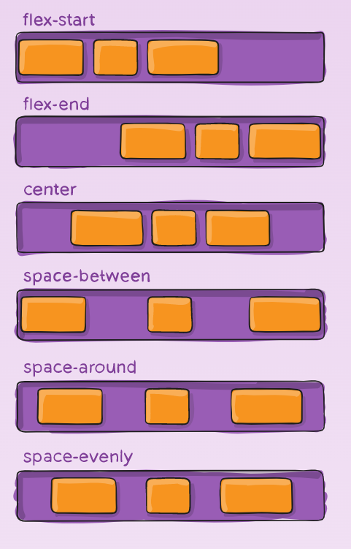
Justify-content
Align items and distribute any extra spacing in the parent container.
The alignment is always along the main axis.
Flex-start ➔ Default value
Flex-end
Center
Space-between
Space-around
Space-evenly

Slide 19
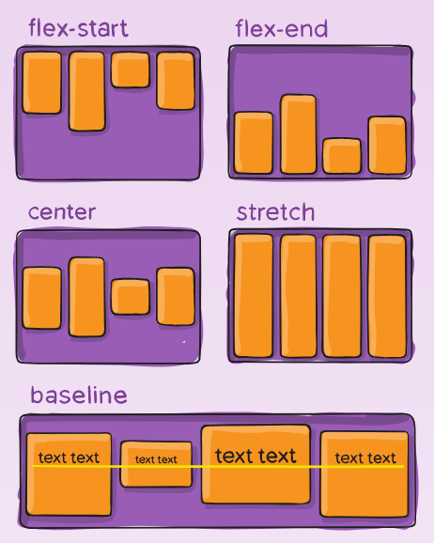
Align-Items
Align items along the cross axis.
Flex-start
Flex-end
Center
Baseline
Stretch ➔ Default value

Slide 20
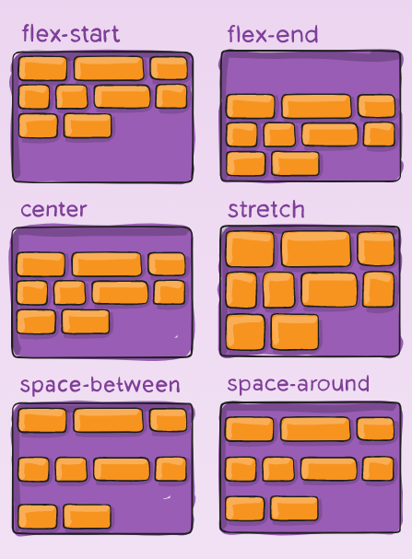
Align-Content
Aligns lines of content along the cross axis and distribute any extra spacing in the parent container .
Flex-start
Flex-end
Center
Space-between
Space-around
Stretch ➔ Default value

Slide 21
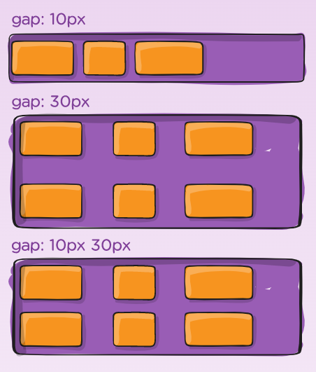
Gap
gap : row column

Slide 22
Flex Items Properties
Order
Flex-grow
Flex-shrink
Flex-basis
Flex
Align-self

Slide 23
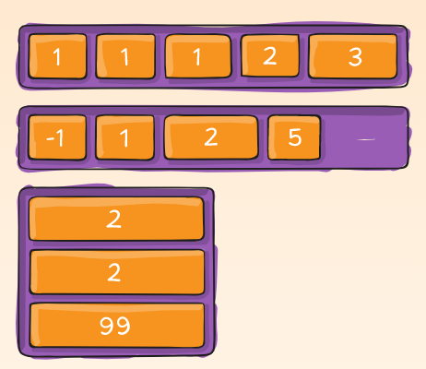
Order
Control the order of items in the flex container .
Zero is the default value .

Slide 24
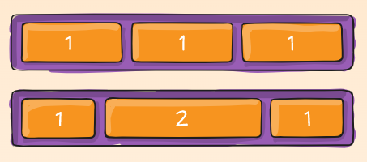
Flex-Grow
Dictates what amount of the available space inside the flex container the items should take up.
Relative to other items in the container.
Default value is zero .

Slide 25
Flex-Shrink
Dictates the shrink factor of the flex items when the default size of flex items is larger than the flex container .
Relative to other items in the container in case of increasing shrink .
Default value is 1 .

Slide 26
Flex-Basis
Set the initial size of flex items.
It accepts pixels , percentages or relative units .

Slide 27
Flex
Shorthand for flex-grow , flex-shrink and flex-basis .
Flex : <flex-grow> <flex-shrink> <flex-basis>

Slide 28
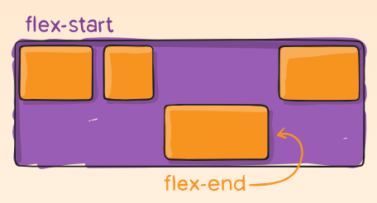
Align-Self
Align items individually .
Overrides the align-items value of the flex container
Auto
Flex-start
Flex-end
Center
Stretch

Slide 29
Media Queries

Slide 30
Media Queries
Tell the browser how to style an element at particular viewport dimensions
Types :
all
Screen
Print
Speech

Slide 31
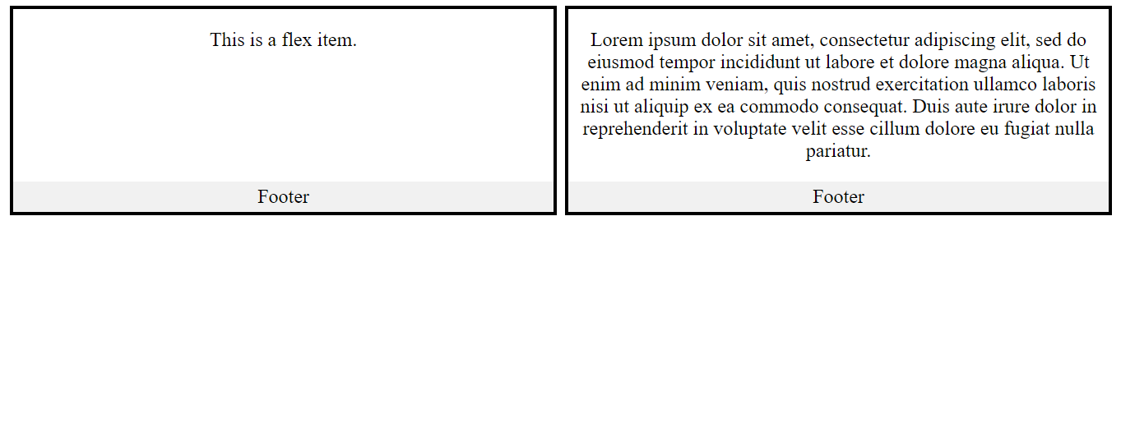
Task_One

Slide 32
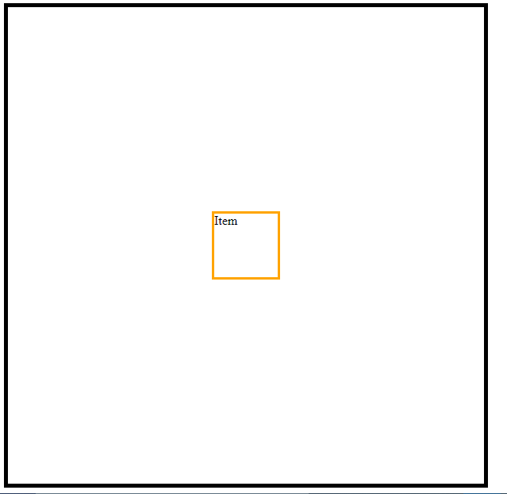
Task_Two

Slide 33
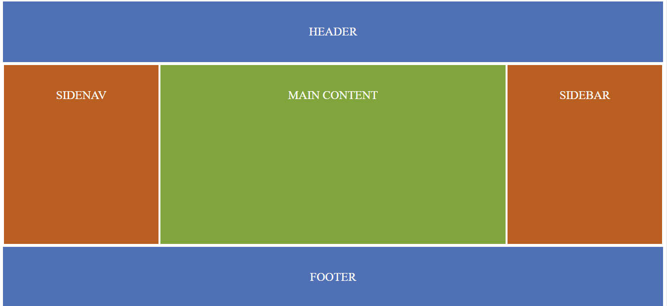
Task_Three

Slide 34
Grid System

Slide 35
Grid System CSS
Two dimensional layout model .
CSS Grid will allow you to manage layout according to both columns and rows.
Flexbox, by comparison, is really just meant for columns (1-D, if you will). Using CSS Grid, designers will be able to achieve layouts that were downright difficult before. In fact, some of these things were on our wish lists since the days of table-based layouts.

Slide 36
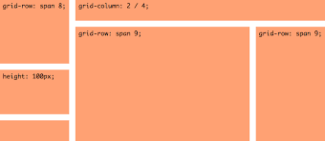
2-D Layout

Slide 37
Terminology
container
items

Slide 38
Two Ways to implement Grid in CSS
Way_one
Grid-template-columns
Grid-template-rows
Grid-column : start/end
Grid-row : start/end

Slide 39
Two Ways to implement Grid in CSS
Way_two
Grid-template-areas
Grid-area

Slide 40
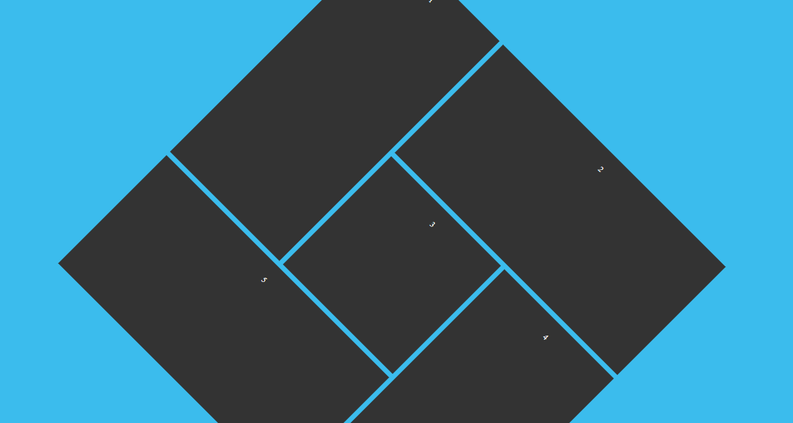
Task_Four

